Slide 1
Intergenerational Impacts & Ongoing Systemic Oppression
Truth and Reconciliation Week 2023

Slide 2
Questions for further reflection:
How do you see the impacts of intergenerational trauma playing out in current societal systems today?
Where can you identify conscious or unconscious bias in various areas of Canadian society – justice, healthcare, child welfare, etc?
What steps can you take to start uncovering and addressing your own unconscious bias?
Where do you see Indigenous resilience despite ongoing systemic discrimination?

Slide 3
Resources (online resources, books, films)
Books:
  A Knock at the Door: The Essential History of Residential Schools from the Truth and Reconciliation Commission of Canada
  Historic Trauma and Aboriginal Healing by Cynthia Wesley-Esquimaux, Cynthia and Magdalena Smolewski (www.ahf.ca)
  21 Things You May Not Know About the Indian Act by Bob Joseph
  The Skin We’re In by Desmond Cole
  White Fragility by Robin DiAngelo
  Unreconciled by Jesse Wente
Film: Reel Injun (2010)

Slide 4

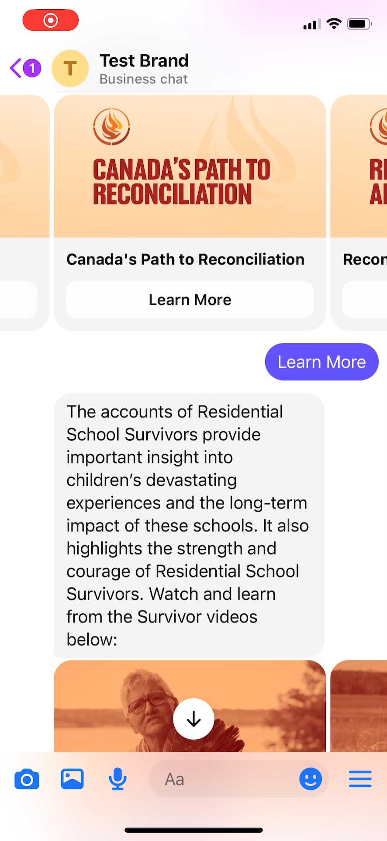


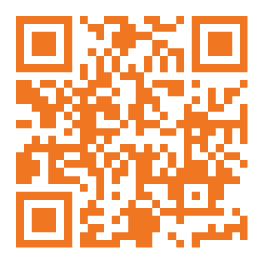
Reconciliation begins with education
Learn more about the truths of residential schools & the path to reconciliation, all through an interactive Messenger experience.
Scan the QR code now!

Slide 5
Thank You
To access the website:
www.nctr.ca
To access the database:
archives.nctr.ca
To ask an archivist:
NCTR@umanitoba.ca
Submit a record request:
NCTRrecords@umanitoba.ca
Education Unit:
Kaila.Johnston@umanitoba.ca
Sandra.Bender@umanitoba.ca
Amber.Ali@umanitoba.ca
Tel.: 1-204-474-6069
Toll free: 1-855-415-4534
visit our Facebook page and social media channels

